Slide 1
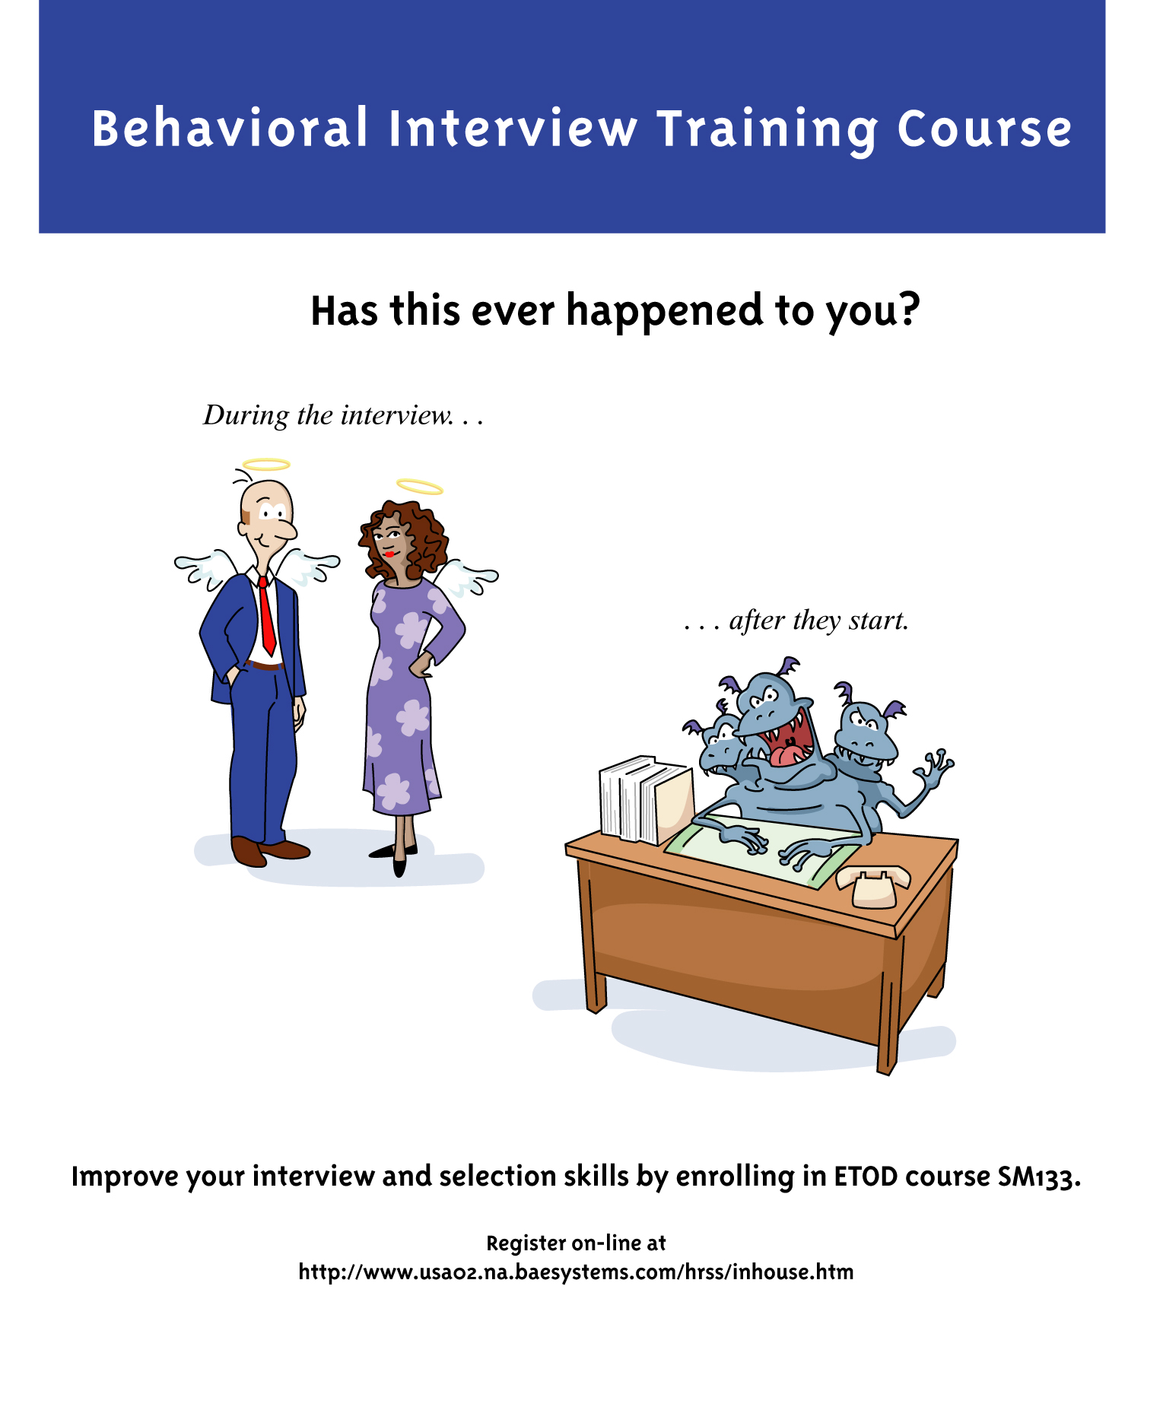

Slide 2
Behavioral Interviewing and Selection
Presenter David Hausmann
HR Specialist E&IS
Notes:
1
1
Presented by Fred Holmes
Erebus Consulting
erebuscon@attbi.com
(978)454-6678
Presented by David Hausmann
BAE SYSTEMS

Slide 3
Course Introduction
Reasons this course was developed
Typical course participants
Program Reviews & Recognition
Resources
    Guide for Hiring New Employees Brochure
    4 Hour Behavioral Interview skills training course
    Web Resources
      Interview theory & tips
      Library of behavioral questions

Slide 4
Guiding Principles Brochure
Take a moment to read the BAE Systems Guiding Principles for New Hires

Slide 5
Guiding Principles
“Everyone who is in a position to hire employees or affect hiring decisions needs to understand that their selections carry great weight for the business as a whole.
Literally every person we hire will impact in some way customer and community perceptions about BAE SYSTEMS.”

Slide 6
Continued Success for
BAE SYSTEMS
Company has made great strides
  Performance
  Work Environment
“Raise the bar” in our hiring practices

Slide 7
Program Goals
Teach interviewers the theory and methodology to conduct effective behavioral interviews
Increase understanding of legal issues inherent in the hiring process.

Slide 8
Interview for the Best
Interview with the intent to bring the best people into BAE Systems
Remember
  Skills can be developed
    Training
    On the Job Experience
    Mentoring
Attributes (attitude, motivation, traits, etc.) are inherent and difficult or impossible to change.

Slide 9
Hiring someone into BAE SYSTEMS represents a huge commitment
Average stay = 14+ years
Over 1.2 million dollars in direct salary
Why we need to hire the best
They become a long term member of our work “family”

Slide 10
Theory of Behavioral Interviewing
  The key to finding out how someone will perform in a job is to collect and analyze examples of how he or she has performed in similar situations in the past
Think like a major league manager – “stats”
Notes:
31

Slide 11
Behavioral Interviewing
In order to make the best hiring decision you need information about the candidate that is:
  Relevant (to the job they’ll do at BAE SYSTEMS)
  Recent (not ancient history)
  Comprehensive description of:
    An Event , An Action they took, and a Result
Otherwise, you’re left with:
  A “gut feel”
  Intuition
  Judgment Call

Slide 12
How would you describe yourself?
Why we need behavioral interviews.
Typical non-behavioral interview question
I am ...
I am ...
I am ...
I am ...
I am ...
Notes:
32
14

Slide 13
How would you describe yourself?
THE TOP FIVE ANSWERS FROM 1000 PEOPLE:
I am a People Person
I am a Hard Worker
I am a Quick Study
I am Dependable
I am a Team Player
Notes:
33
15

Slide 14
Non-behavioral interview approach
What projects have you worked on
  Our company worked on this… and then we did that… and after that I did this other thing
What experience do you have with…?
  I have experience with this… and on that… and with the other thing.

Slide 15
Non-behavioral interview approach
I lead the group to a successful conclusion!
  Three heart attacks – two went to another company-but only one suicide
I asked for others opinions, I always do.
  I couldn’t make a decision on my own

Slide 16
Benefits of using behavior
Eliminates misunderstandings about the candidates Skills and Attributes
Limits personal impressions from affecting your evaluations
Limits the possibility of candidates “faking it” with vague generalizations
Notes:
36

Slide 17
Types of Information Needed
SKILLS
  Work Experience \ Education \ Certifications \ Knowledge
    Specific Experiences
    Who, What, When, Where, How
ATTRIBUTES
  Motivations
  Attitudes
  Interests
  Desires

Slide 18
FILM
More Than A Gut Feeling
Notes:
NEXT – Needed Job Skills – Job Skills
VIDEO – Black Ties and Terrors

Slide 19
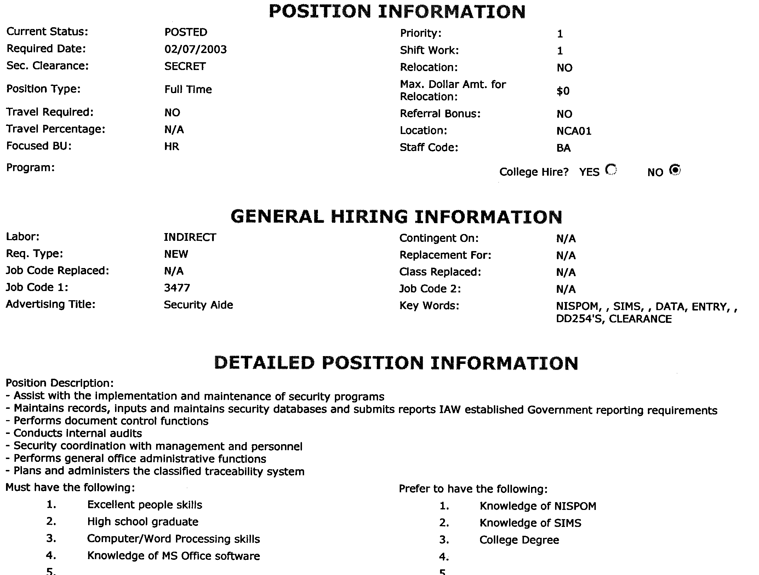
Opening a Requisition
More than the company’s job description

Slide 20
A Job Requisition is your Shopping Guide
A well written job Requisition is:
  A road map
  Statement of work
  System requirement statement
It tells you what you need in Skills and Attributes to get the job done
It defines the job for you and your interview team

Slide 21
A Job Requisition is also the candidate’s guide
It is the candidate’s first look at your requirement (on the web)
It defines the job for the candidate so be clear in your language
  Specify the important things
  Don’t use BAE SYSTEM acronyms or language unknown outside the company
  Tailor the description to your business group

Slide 22
Key Job Requirements provide:
Defined standards to measure candidates against
  Evaluate all candidates against them
  Base hiring decisions on how well candidates meet the requirements
Provides legal creditability
Notes:
29
12

Slide 23
Key Job Requirements
Major Categories
Skills
  Technical / Professional Knowledge
    Do they have the knowledge to do the job?
Attributes
  Attitudes / Traits
  Will they fit into our high performance culture
  Behaviors
    Motivation
    Will they do the job?

Slide 24
BAE SYSTEM’S
Management Guiding Principles
Attributes (Traits - Motivations)
Honesty
Integrity
Treat others with:
Courtesy
Respect
Dignity
Sense of calmness
Focus on truly important tasks
Commitment to meet customers expectations
Motivated to add value to the company and to enhance our work environment
Humility to work as a team member
Committed to doing the right things, even in the face of adversity and difficulty

Slide 25

Conducting a Behavioral Interview
Skills &
Attributes
Behavioral
Interviewing
Notes:
VIDEO - Right Piece, Wrong Puzzle

Slide 26
Good Interviewing gives you an E.A.R.
E
The Event Background Information
(What, When Why, Where , Who)
A
Action taken by candidate
R
Results of Action (+ or -)
Notes:
34
16

Slide 27
Why ask for an E.A.R. full?
Event - gives you the background information you need to understand the example
Action – Clarifies exactly what the candidate did or didn’t do
Result – Clarifies what happened as a result of the candidate’s actions

Slide 28
Why you need to ask behavioral questions and then probe for details.
Film: Smoke & Mirrors

Slide 29
Well formed questions are essential
Ask for specifics
  What, when, where, why, how, who…
Ask for behavioral information
  Focus on recent events and examples
Stay relevant
  Pertains to the job requirements and Guiding Principles
  Key skills and attributes
  Essential Functions

Slide 30
Open Ended Questions
  Cannot be answered by a few words
  Ask for a description of a past experience
  Invites explanations and comments
Examples
“Tell me about a time…”
“Give me an example of …”

Slide 31
Open Ended Questions
Your job as an interviewer
Develop open ended questions to solicit examples of tasks and events that are similar to those in the job that will give insights into the skills and attributes needed to be successful in the position.

Slide 32
Interview Questions
Ask the right questions or
Garbage out = Garbage in
Future or Theoretical
Leading
Behavioral
  Event
  Action
  Result.

Slide 33
Leading questions
Leading question telegraph what the “right” answer is
  Do you like working in a fast pace environment?
  Do you like working on a team?
  How did that work out?
  Did that resolve the issue?
Stick with:
What happened and the result

Slide 34
Theoretical Question Elicit Theoretical Answers
Theoretical questions let the candidate give you the “text book” answer
  If you were in charge, what would you do?
  How do you handle discipline?
  How do you select employees?
Walk me through an instance when…
Give me a recent example of…

Slide 35
Using Probing Questions for Better Understanding
Tell me more

Slide 36
Partial E.A.R. responses
You may only get one or two of the components
Event - Action - Result
You must probe and get the missing component(s).
Notes:
EXERCISE – Recognizing EARs
VIDEO & EXERCISE - STARS

Slide 37
What was the result? How did that affect . . . ? How were these outcomes directly related to what you did? What problems, successes resulted . . . ?
How did you know the results of what you did ?
What feedback have you gotten?
Event
Action
Result
What were the circumstances surrounding... ?
Describe what led up to…
Who was the customer (co-worker, team member)?
Give me a specific situation in which you used that approach.
What was the most memorable time when that happened?
What caused you to . . . ?
When was that?
What were you reacting to?
Exactly what did you do?
How were your actions different here from . . . ?
How did you react? Describe specifically how you did that.
What was your part of the project, and how did you handle it?
Walk me through the steps you took...
What did you say to him?
What did you do first . . . second . . . ?

Slide 38
Contrary Evidence
Get a rounded view of the candidate
Probe for contrary evidence
  If you have all positives, probe for a negative
  If you are seeing all negatives probe for a positive
Notes:
Exercise – Written:Types of Questions
Exercise – VIDEO: Write down what the interviewer says

Slide 39
Interviewer Pitfalls
First impressions
Stereotyping
Personal bias
Halo effect
Spitting image (same school, background, etc)
Pressure to fill the job

Slide 40
Interviewee Pitfalls
Sometimes the candidate just doesn’t give you the information you need

Slide 41
Beware of …
Ambiguous Statements
  All glitter, no substance (view from 10,000 feet)
Opinions
  Everyone has them
Theoretical - Future Oriented Statements
  Stay out of the “woulds”
    I would do …

Slide 42
Interview Tips
Put candidate at ease
One question at a time
Applicant may get stuck looking for world class example
  Be patient
  Use silence

Slide 43
Interview Tips
Explore the “Gold Mines”
  If the door opens - walk through
Combine technical and behavioral
Watch your time
It’s OK to say “I don’t understand”
Take notes

Slide 44
To get information, be a good listener
TURN OFF YOUR WORRIES
PREPARE IN ADVANCE
THINK LIKE THE OTHER PERSON
REACT TO IDEAS NOT THE PERSON
DON'T JUMP TO CONCLUSIONS
LISTEN FOR OVERTONES
DON'T INTERRUPT UNLESS YOU NEED TO REDIRECT
DON’T TRUST YOUR FIRST IMPRESSION
ASK PROBING QUESTIONS
USE REFLECTIVE PHRASES
LIMIT YOUR TALKING
LISTEN FOR IDEAS
USE LISTENING RESPONSES
CONCENTRATE
TAKE NOTES

Slide 45
RECAP
Benefits of using behavior
Eliminates misunderstandings about candidate’s skills and attributes.
Limits personal impressions from affecting your evaluations
Limits the possibility of candidates “faking it” with vague generalizations
Notes:
36

Slide 46
Interviewing Process

Slide 47
Pre-Interview Planning
Hiring Manager
Select departmental interviewers
Prepare and distribute an agenda & resume
Clearly identify the key Skills & Attributes
Assign question areas to interviewer
Set expectations for feedback
  written interview evaluation forms
  group data integration meeting

Slide 48
Pre-Interview Planning
Individual Interviewer
Review the position requisition
Make sure you understand the required Skills and Attributes
Know the areas you are responsible for probing
Prepare open ended interview questions
Review candidate resume

Slide 49
At $20,000/min you’d better manage the interview!
Explain the interview plan in the opening
Compliment candidates for concise and complete E.A.R. statements
If too much detail, remind candidate about time limitations
Don’t let them ramble, redirect candidates to a specific area

Slide 50
Group Interviews
On the Job Training

Slide 51
Advantages of Group Interviewing
A Best Practice
Allows interviewers to learn from one another
Everyone hears the same candidate responses
Gives you time to listen and reflect
Allows candidate to get a sense of “The Team”
Facilitates effective and timely data integration

Slide 52
Risks and Benefits
What are the risks?
  Exposure – you’re not an “expert”
Benefits
  Learn new skills
  Make better hiring decisions
  Improve your group’s performance
  Look like a superstar
  Greater return on investment

Slide 53
Group Interview Pre-Planning
Identify an interview leader
Recommend keeping the group to 4 or less
Use name tags or tent cards to identify participants – Name and position
Discuss the group interview with the applicant
Clearly identify the Hiring Manager or Supervisor

Slide 54
Good Rapport leaves a Good Impression
Maintain or enhance self-esteem
  Give sincere and specific feedback
  Minimize negative information
    Rationalize negative questions and responses
    Listen and Respond with Empathy
The candidate should feel good about the interview and BAE SYSTEMS even if they don’t get the job

Slide 55
Data Evaluation &
Integration
A Critical Step in selecting good employees
Data Evaluation

Slide 56
Summarize and record interview impressions immediately after the interview
Spend time immediately after the interview to go over your notes
  Jot down initial impressions
  Rate the candidate on the job’s requirements
  Review information for completeness
  Complete an evaluation form
Notes:
VIDEO – Smoke and Mirrors

Slide 57
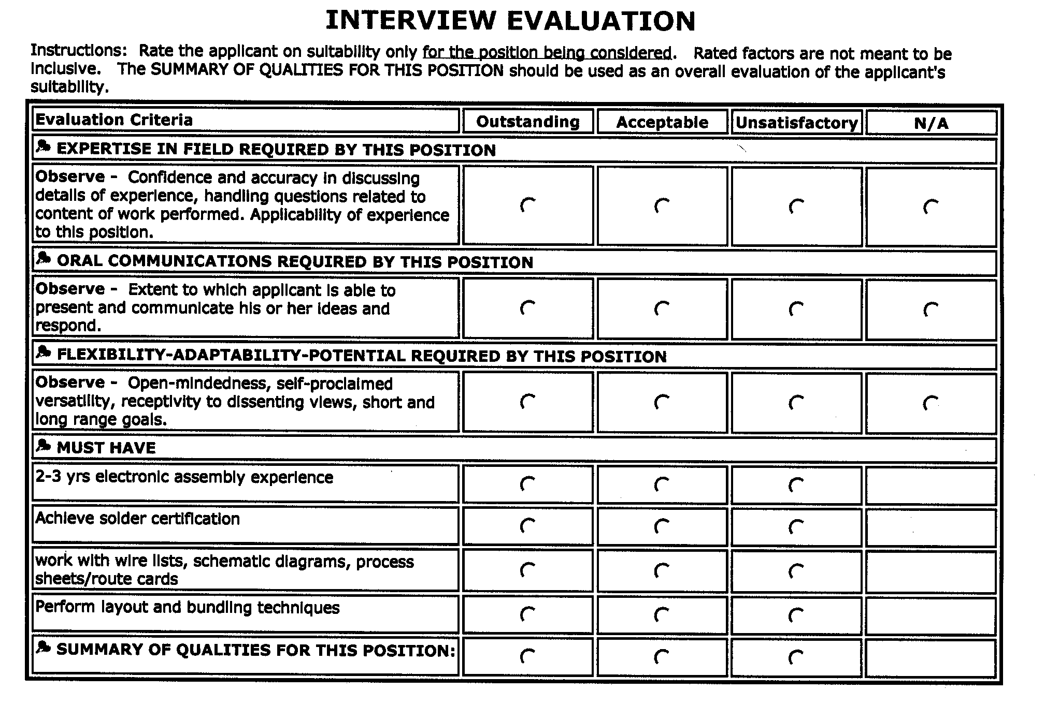
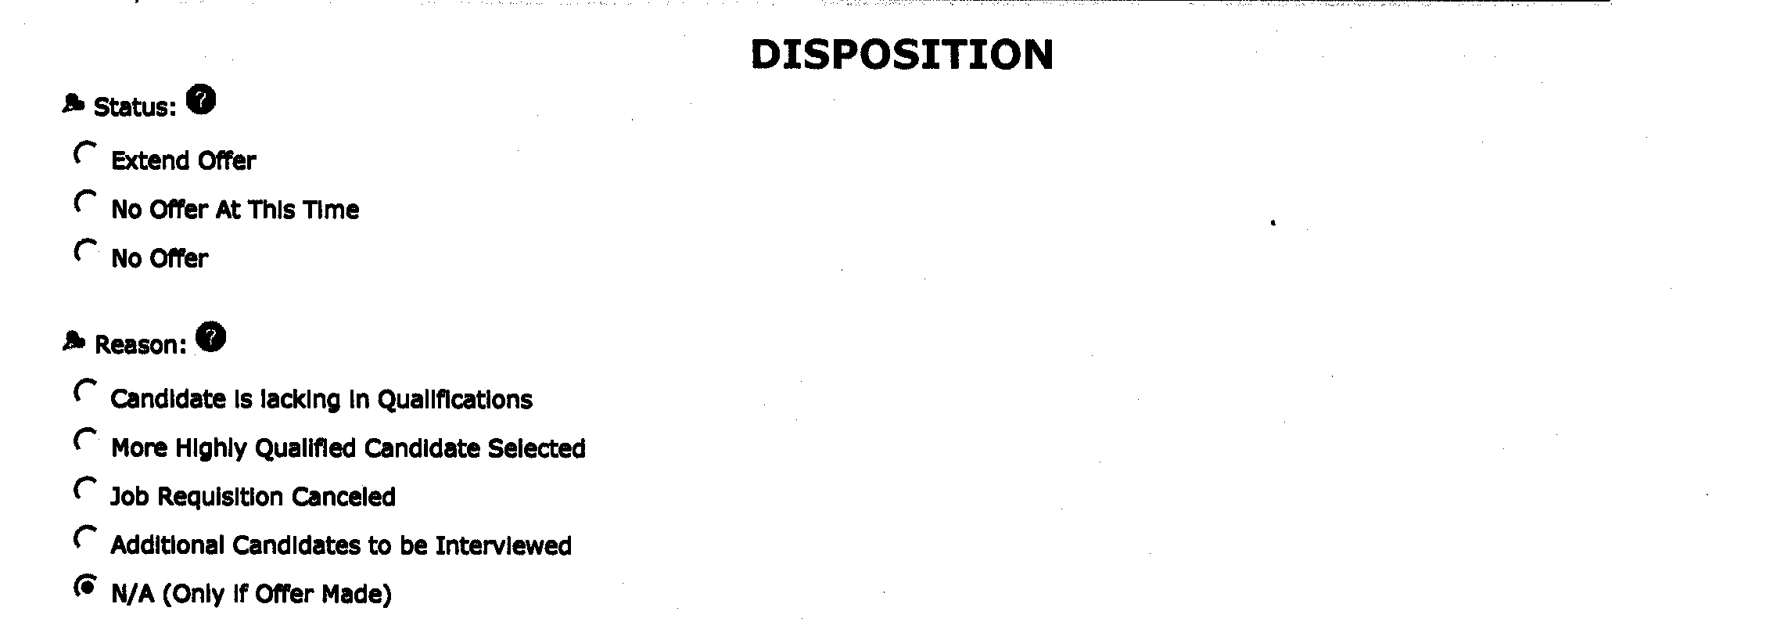
Interview Evaluation Form

Slide 58
Areas to focus on in evaluation
Can They Do the Job?
  Skills, knowledge and experience
Will They Do the Job?
  Attributes (attitudes, motivations and inherent traits)
Do they fit the job & company?
  Match these against the Guiding Principles and job requirements
  Over-qualified?
  Will they “like” the job

Slide 59
E&IS Evaluation Tool
Candidate Name_____________________________
Position Interviewed for_______________________
Recruiter Name______________________________ Interview Date ________________
Candidate Evaluation
Excellent Above Average Average Poor
Humility/Teamwork ____ ____ ____ ____
Performance ____ ____ ____ ____
Motivation ____ ____ ____ ____
Communications ____ ____ ____ ____
Judgment ____ ____ ____ ____
Courtesy/Respect ____ ____ ____ ____
Leadership ____ ____ ____ ____
Overall Assessment ____ ____ ____ ____
Comments
___________________________________________________________________________
___________________________________________________________________________
___________________________________________________________________________
___________________________________________________________________________
___________________________________________________________________________
___________________________________________________________________________
___________________________________________________________________________
___________________________________________________________________________
___________________________________________________________________________
___________________________________________________________________________

Slide 60
Additional Information Observed
Pay attention to all the information you received: Some you get for free!
Did they treat you with respect?
Creditable/Believable
  Openly shares both positive and negative information
Communication Skills
Level of preparedness
What is the style of the candidate
  Timid -Aggressive
  Enthusiastic
  Energy level

Slide 61
Data Integration
Collect input from all interviewers
Categorizing Behavioral Examples
    Recent +
    Direct transferable skill +
    Significance of skill +
    Positive trend +
Rate the candidate against the Job Requirements and Guiding Principles

Slide 62
Group Evaluation Meetings
A Best Practice
Facilitates interviewers ability to:
Discuss and integrate the data
Share insights
Look for inconsistencies
Discuss pros and cons
Buy-into the candidate
Reach consensus

Slide 63
ELDP Homework Assignment #1
List the actual things (tasks) that must be done to provide satisfactory performance as an ELDP. Prioritize that list
List the Skills and Attributes needed by a candidate to successfully perform the job tasks. Prioritize that list.
  Also list the reasons people fail to be successful – that may give you additional information.

Slide 64
Things to include
What will the ELDP do?
What skills must they have?
What attributes (motivation/traits) must they have to succeed?
What attributes (motivation/traits) cause them to underachieve or even fail?
What cultural attributes must be present to meet our Guiding Principles?

Slide 65
ELDP Homework Assignment #2
ELDP Behavioral Interview Guide
Develop a Interview Guide including the questions you’ll ask to insure candidates have the skills & attributes to be successful ELDP’s

Slide 66
Homework Assignment Discussion & Review 10/27
Develop a group consensus on
  The major tasks new ELDP’s will perform
  The Skills & Attributes they will need to be successful include the Guiding Principles
  An interview guide to be used in this years selection process

Slide 67
LEGAL ISSUES in the
HIRING PROCESS
Equal Employment Opportunity
Americans with Disabilities Act
Pre-employment Inquiries

Slide 68
TITLE VII OF THE
CIVIL RIGHTS ACT OF 1964
Prohibits discrimination in employment based on race, sex, religion or national origin

Slide 69
AGE DISCRIMINATION IN EMPLOYMENT ACT
1967
Prohibits employment discrimination against individuals who are over age 40
And in N.H. the protected age is…?

Slide 70
EXECUTIVE ORDER 11246 (AS AMENDED)
Requires federal contractors to take positive steps toward eliminating the present and future effects of past discrimination against women and ethnic minorities

Slide 71
Handout
Legal Quiz

Slide 72
SECTION 503 OF THE REHABILITATION ACT OF 1973
Prohibits discrimination against qualified persons because of a disability or a history of disability. Also requires government contractors to take Affirmative Action to employ and advance qualified disabled individuals

Slide 73
AMERICANS WITH DISABILITIES ACT OF 1990 (ADA)
Prohibits discrimination against people with disabilities and guarantees Equal Opportunity in public accommodations, employment, transportation, state and local government services, and telecommunications

Slide 74
THE CIVIL RIGHTS ACT OF 1991
Amends Title VII and the ADA to include jury trials for compensatory and punitive damages.

Slide 75
AMERICANS WITH DISABILITIES ACT TITLE 1 - EMPLOYMENT
Illegal for employers or supervisors to discriminate against a qualified
person with a disability in:
  Hiring - Firing - Salary -Training Promotion
  Any other term or condition of employment

Slide 76
“PERSON WITH A DISABILITY”
The term “disability” means:
  a physical or mental impairment that substantially limits one or more of the major life activities;
    without regard to mitigating measures
  a record of such an impairment; or
    e.g., former cancer patient
  being regarded as having such an impairment.
    perceived by employer
    attitude of others
    rumors
ADA also prohibits discrimination on the basis of a known relationship, or association with an individual with a known disability.

Slide 77
“QUALIFIED INDIVIDUAL WITH A DISABILITY”
“Qualified individual with a disability” is an individual with a disability, who with or without reasonable accommodation, can perform the essential functions of the employment position that such individual holds or desires

Slide 78
ESSENTIAL FUNCTIONS
“Fundamental” job duties.
The key tasks, duties and responsibilities of the job
Reason job exists
Does not include marginal functions

Slide 79
Examples of Essential Functions
Essential Functions are key tasks that must be accomplished to satisfactorily complete the job
Clerks must enter data into a spreadsheet
Firemen must climb ladders even though the task is done infrequently
Ability to answer a phone is essential to a telephone operator but not necessarily essential to a clerk.

Slide 80
ESSENTIAL FUNCTIONS
Example Assembly Specialist E&IS Final Assembly focused factory

Slide 81
EXERCISE
Essential Functions
For an ELDP

Slide 82
Essential Functions for ELDP
Ability to understand and follow complex policies & procedures
Ability to communicate (written & verbal) with employees at all levels of the organization
Use a computer to input and analyze information
Capable of successfully dealing with stressful circumstances

Slide 83
Don’t need to lower the Requirements
Normal productivity level
Education &Skills
Work experience
Licenses or certifications
Physical and mental abilities
Attendance
Health and Safety
Other job-related requirements, such as judgment, ability to work under pressure or interpersonal skills

Slide 84
REASONABLE ACCOMMODATIONS
  Modifications or adjustments to a job or work environment that:
    Are required to ensure equal opportunity in the job application process.
    Allow employees with disabilities to enjoy benefits and privileges of employment equal to those available to employees without disabilities.
    Enable employees with disabilities to perform the essential functions of the job.

Slide 85
EXAMPLES OF
REASONABLE ACCOMMODATION
Job restructuring, part-time or modified work schedules. May require modification of the job, i.e., assignment of non-essential tasks to other employees, schedule changes, etc.
Acquiring or modifying equipment or devices
Requiring the hiring of additional employees as readers and interpreters.

Slide 86
PRE-EMPLOYMENT INQUIRIES
Employers may not ask:
about the existence, nature, or severity of any disability an applicant may have or that the interviewer may perceive the applicant to have.
Not This:
Have you ever had back trouble?
Do you have a visual impairment?
Have you ever had a heart attack?
Alternative:
Can you lift 50 pounds?
q This job requires a driver’s license. Do you have one?
This position can become stressful at times when the completion of a proposal is necessary by a certain date. Can you handle that type of stressful situations?

Slide 87
In Summary
Notes:
Film Summary – More than a Gut Feeling
Analyze the Job Skills
Identify technical skills
Specific knowledge and skills
Identify performance skills
Job tasks and responsibilities
Develop Open ended behavioral questions
Establish Rapport
Ask the open-ended behavioral questions
Listen and evaluate the answer
Ask probing questions to clarify the answer
Seek contrary evidence
Rationalize the question when seeking negative
evidence
Maintain Control of the interview

Slide 88
Simple Concepts
What someone has done in the past is the best predictor of what they will do in the future
Raising the hiring standards at BAE SYSTEMS
From a legal point of view:
  Increase your awareness of ADA
  Many company resources are available to help you
    Legal
    EEO Representatives
    Medical
    HR Colleagues
  We can’t help you if you ask illegal questions during the interview process

Slide 89
Program Goals
Increase your understanding in the theory and methodology of behavioral interviewing
Increase awareness of ADA in the employment process
Improve the BAE Systems’ ability to select strong candidates

